Slide 1
CCNA 1 v3.1 Module 2
Networking Fundamentals

Slide 2
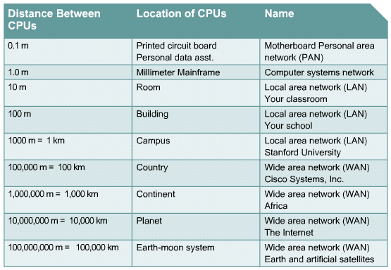
Data Networks

Slide 3
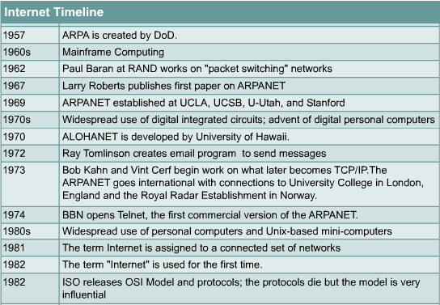
Network History

Slide 4
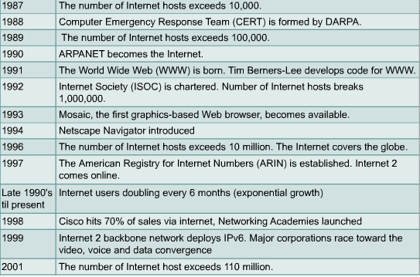
Network History continued

Slide 5
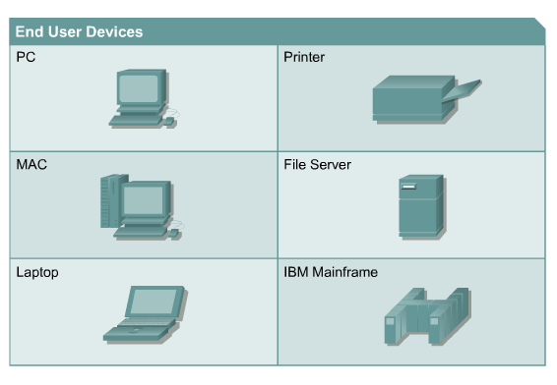
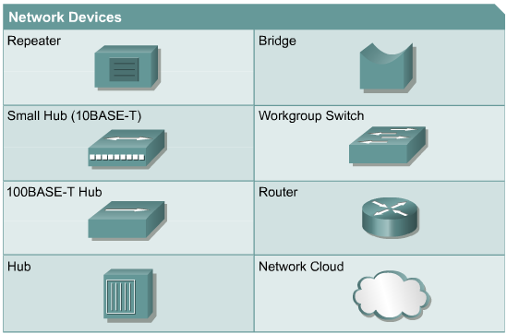
Networking Devices

Slide 6
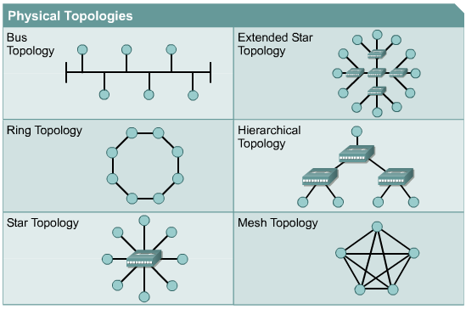
Network Topology

Slide 7
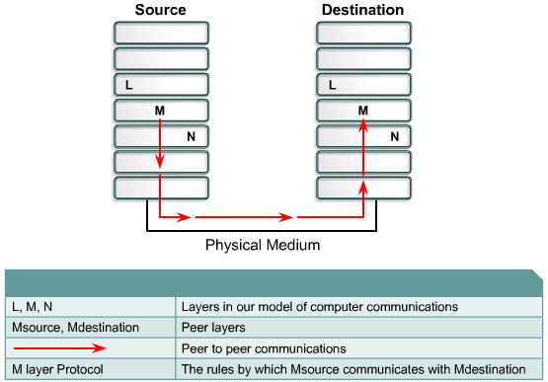
Network Protocols

Slide 8
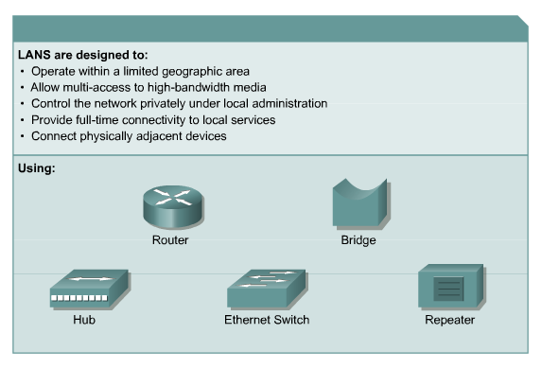
Local-area Networks (LANs)

Slide 9
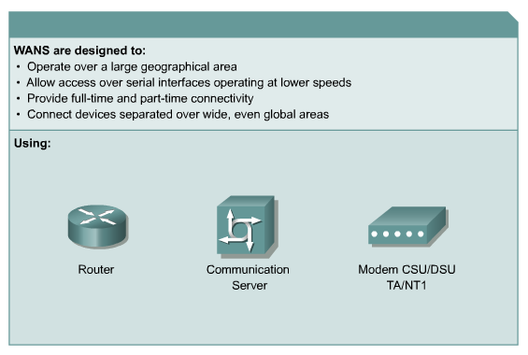
Wide-area Networks (WANs)

Slide 10
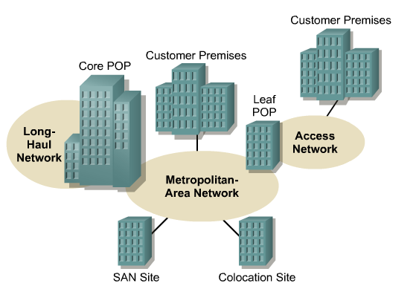
Metropolitan-Area Network (MANs)

Slide 11
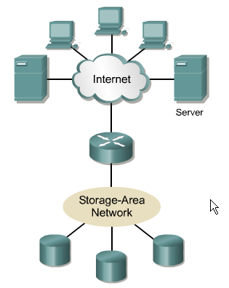
Storage-Area Networks (SANS)

Slide 12
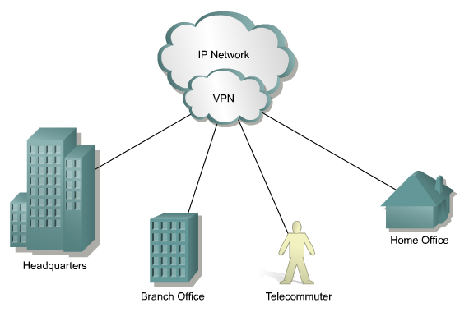
Virtual Private Networks (VPNs)

Slide 13
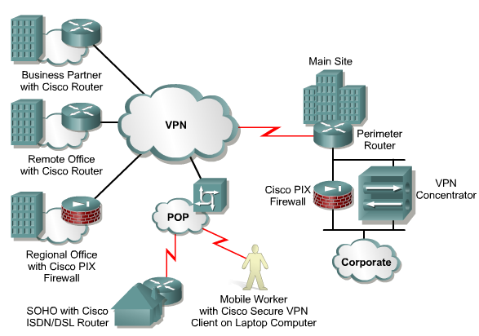
Benefits of VPNs

Slide 14
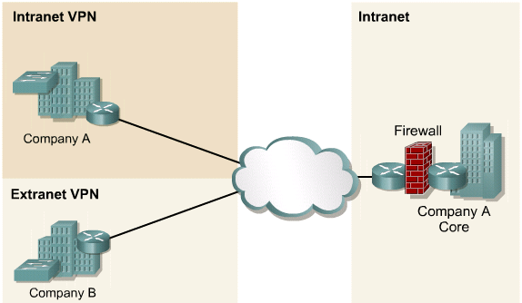
Intranet and Extranet VPN

Slide 15
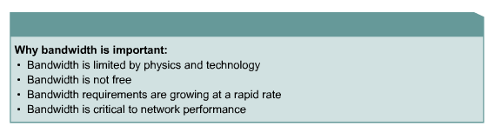
Importance of Bandwidth

Slide 16
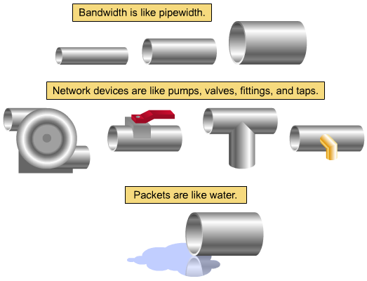
Bandwidth Pipe Analogy

Slide 17
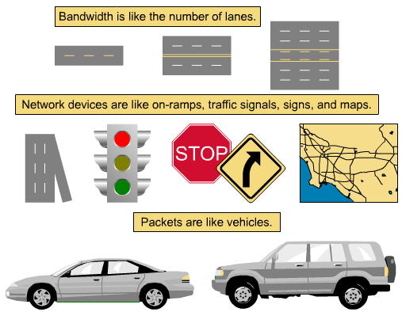
Bandwidth Highway Analogy

Slide 18
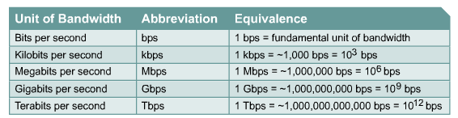
Bandwidth Measurements

Slide 19
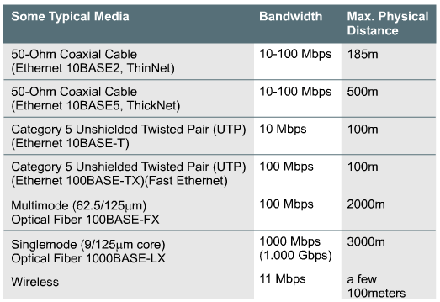
Bandwidth Limitations (Know this stuff)

Slide 20
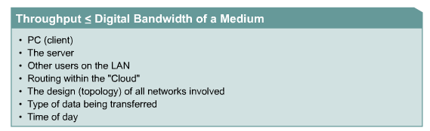
Bandwidth Throughput

Slide 21
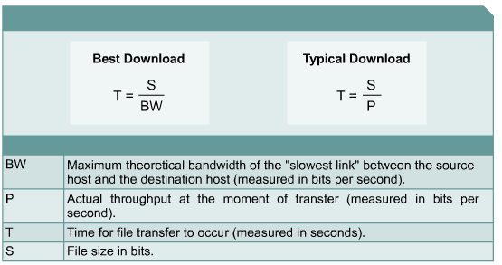
Digital Transfer Calculation

Slide 22
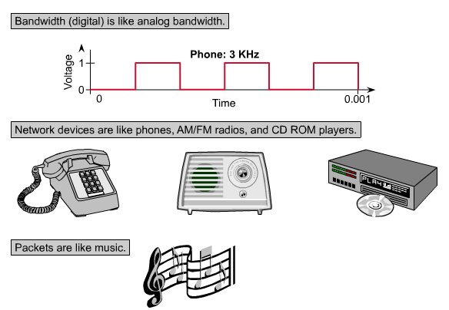
Digital versus Analog

Slide 23
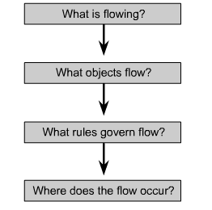
Using Layers to Analyze Problems

Slide 24
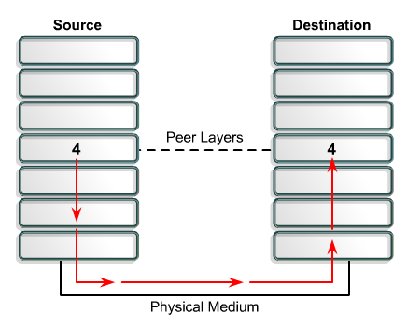
Using Layers to Describe Data Communication

Slide 25
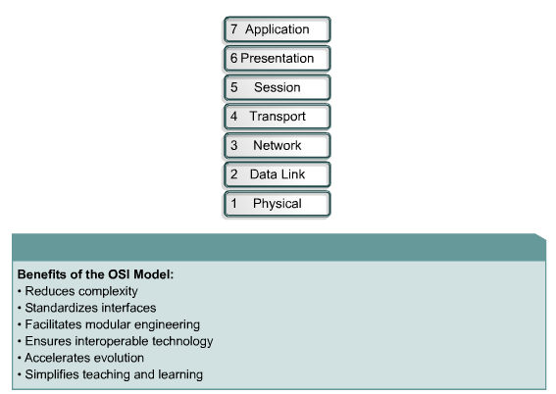
OSI Model (Important to know)
Away
Pizza
Sausage
Throw
Not
Do
Programmers

Slide 26
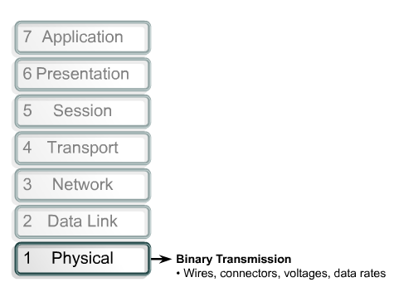
OSI Layers

Slide 27
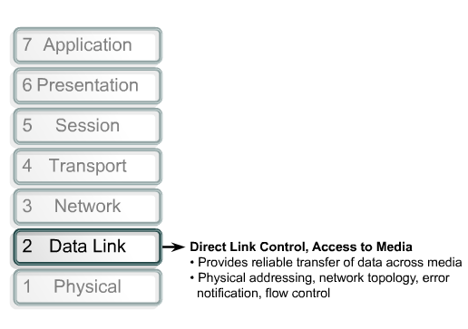
OSI Layers
Provides connectivity and path selection between two host
Provides Logical address
No error correction, best effort delivery.

Slide 28
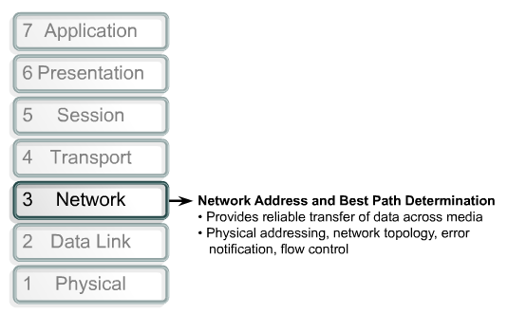
OSI Layers

Slide 29
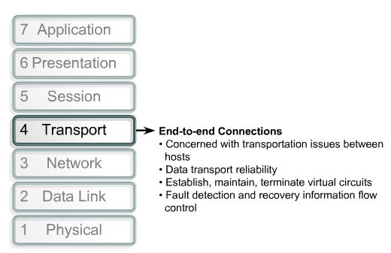
OSI Layers

Slide 30
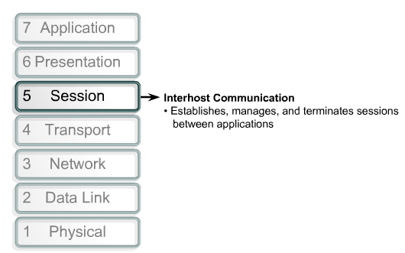
OSI Layers

Slide 31
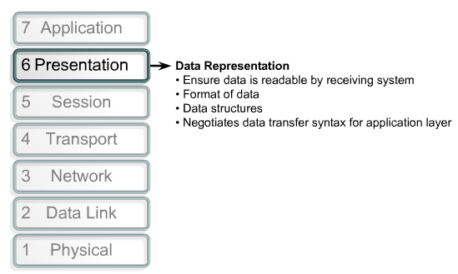
OSI Layers

Slide 32
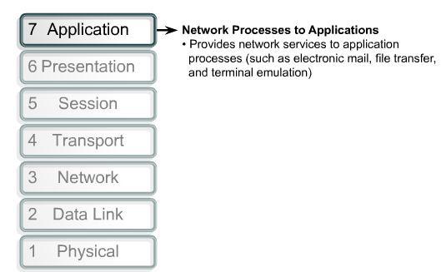
OSI Layers

Slide 33
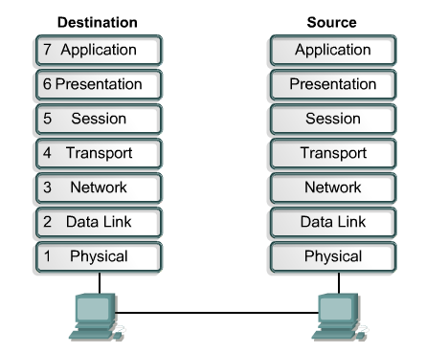
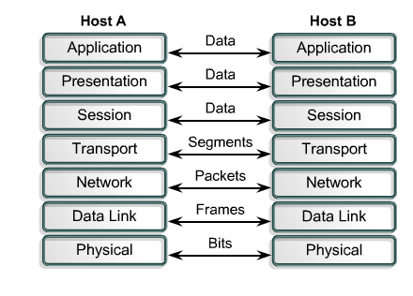
Peer-to-Peer Communication

Slide 34
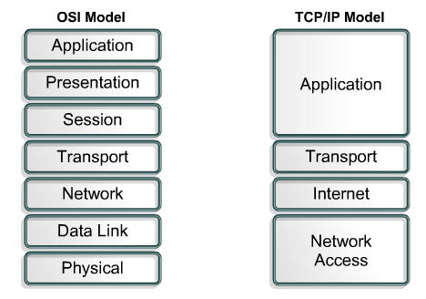
TCP/IP Model

Slide 35
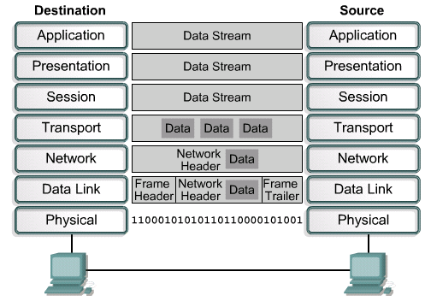
Encapsulation
Data
Data
Data
Segments
Packet
Frame
Bits

Slide 36
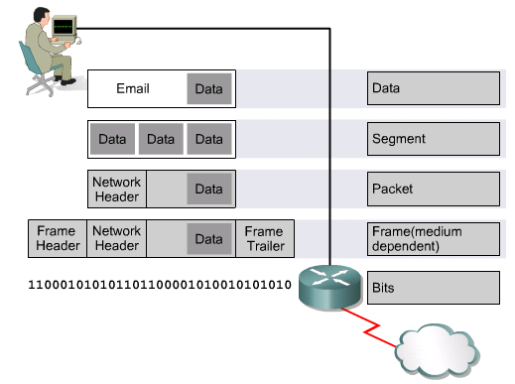
Names for Data at Each Layer

Slide 37
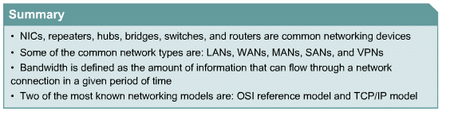
Summary

